Slide 1

PENSION MANAGEMENT SYSTEM
Submitted by-
ABHISHEK KUMAR
(abhishekkrsinha39@gmail.com)

Slide 2
Contents in the project:-
Pension Management Portal (Front-end in Angular).
Three microservices, namely-
Authorization microservice.
Pensioner Detail microservice.
Process Pension microservice.

Slide 3
Technologies Used:-
Front End: Angular
Back End: Java, Spring Boot, Restful-Services, JUnit.
Database: H2-database
Tools: Eclipse IDE, Postman, Visual studio code
Cloud: AWS

Slide 4
Introduction:-
Pension Management System is an application by which the State government aims to automate a portion of the Pension detail provisioning.
This project covers pensioner detail provision, calculate provision and displaying it on the UI.
In this project, on the UI, an authorized user can log in and fill in the details of pensioner (in project terms, input to the process pension microservice), then internally application will call pensioner detail microservice and if the details entered would be correct then pension calculation will be done and will be returned on the UI to the user alongwith the bank service charge.
If the details entered would be wrong, then error message will be displayed.

Slide 5
Authorization Microservice:-
In authorization microservice, JWT and spring security are used.
In this microservice, there are three endpoints.
First endpoint takes username and password in request body and then if these are matched with database entry, token is generated and returned to the user for other microservices.
Second endpoint is for validation. This endpoint takes token in header and returns true and http status OK only if token is not expired and valid.
Third endpoint is just for Status Check. If the service is up and running, it returns OK.

Slide 6
Authorization Microservice
Localhost screenshots are from slide 7 till 12.
AWS (Cloud) screenshots are from slide 13 till 18.

Slide 7
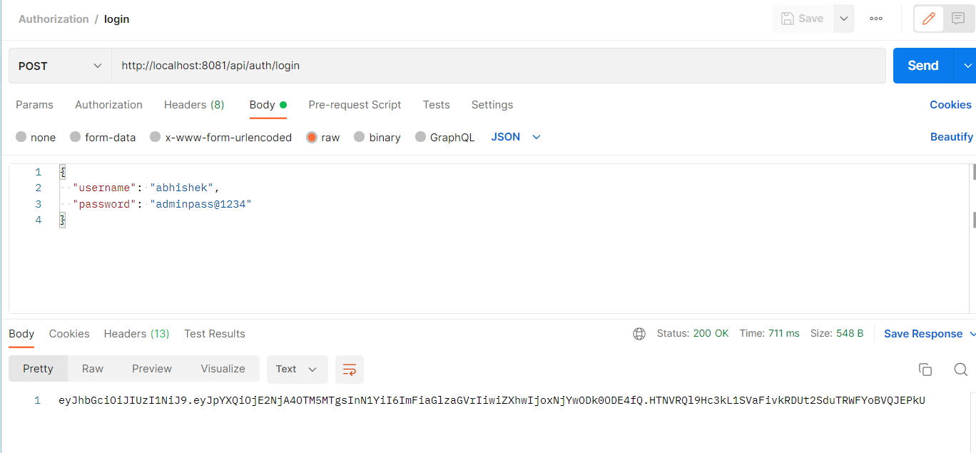
Authorization Microservice- Valid User

Slide 8
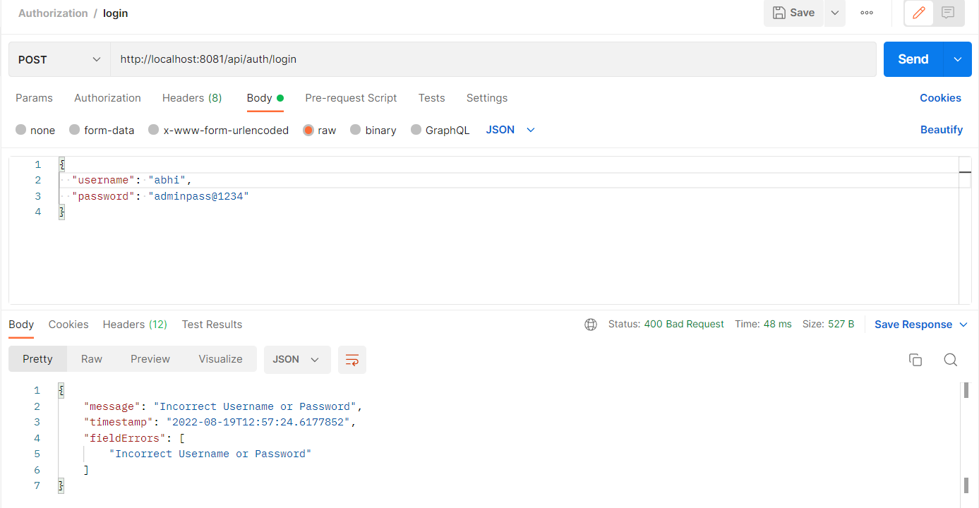
Authorization Microservice- Invalid User

Slide 9
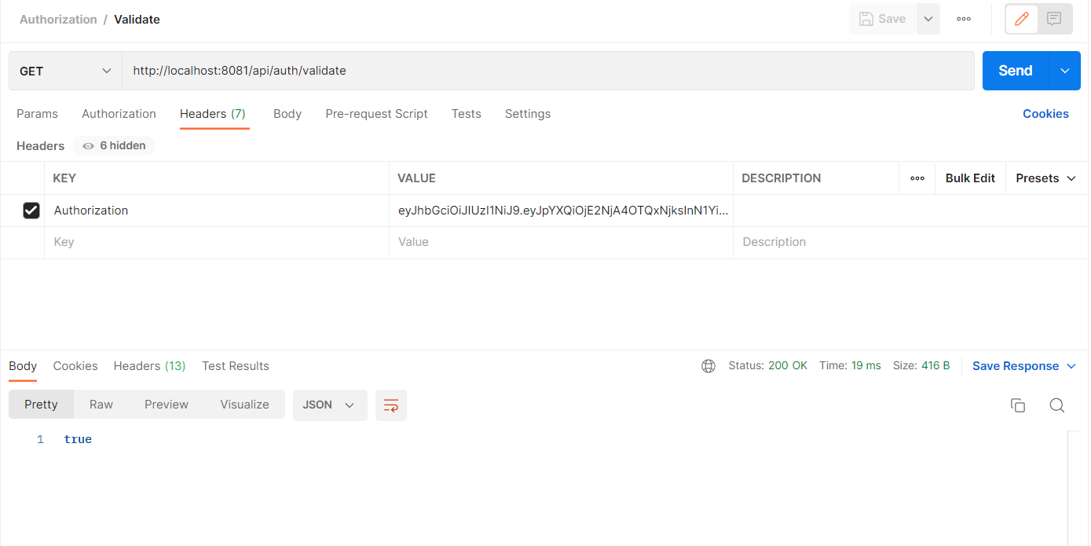
Authorization Microservice- Valid token

Slide 10
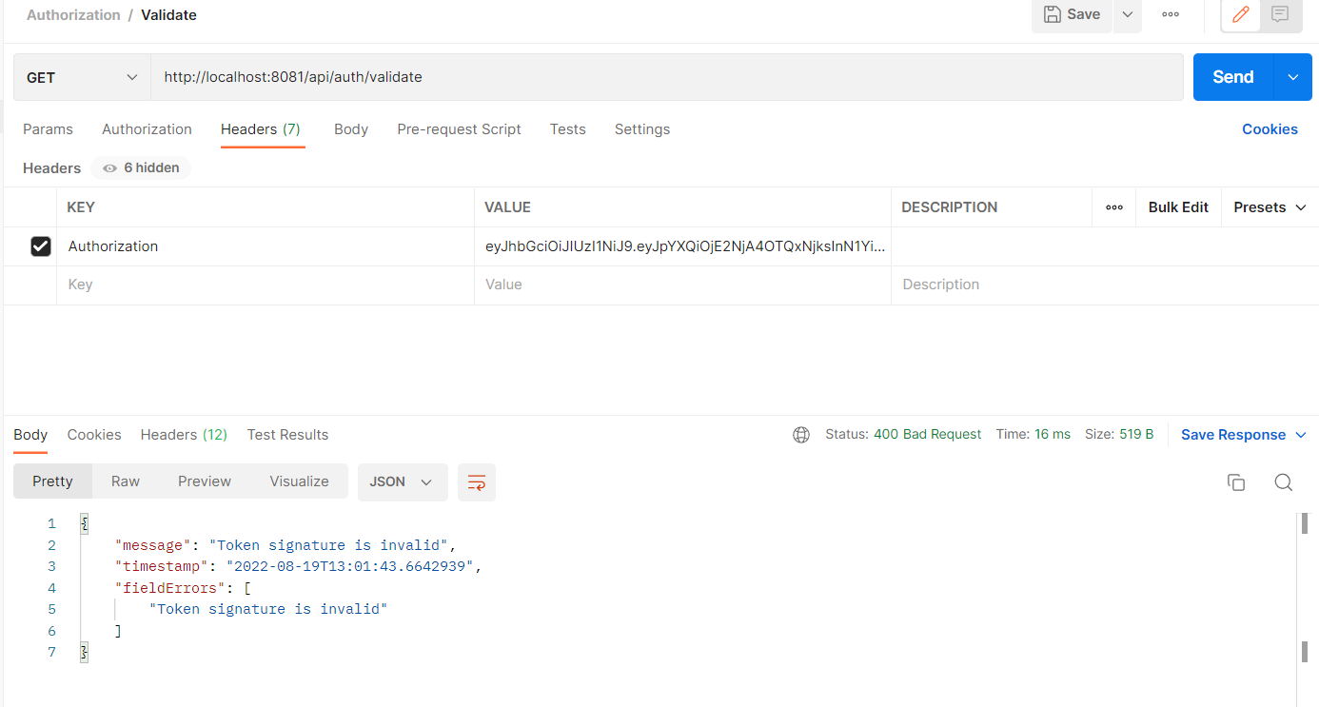
Authorization Microservice- Invalid token

Slide 11
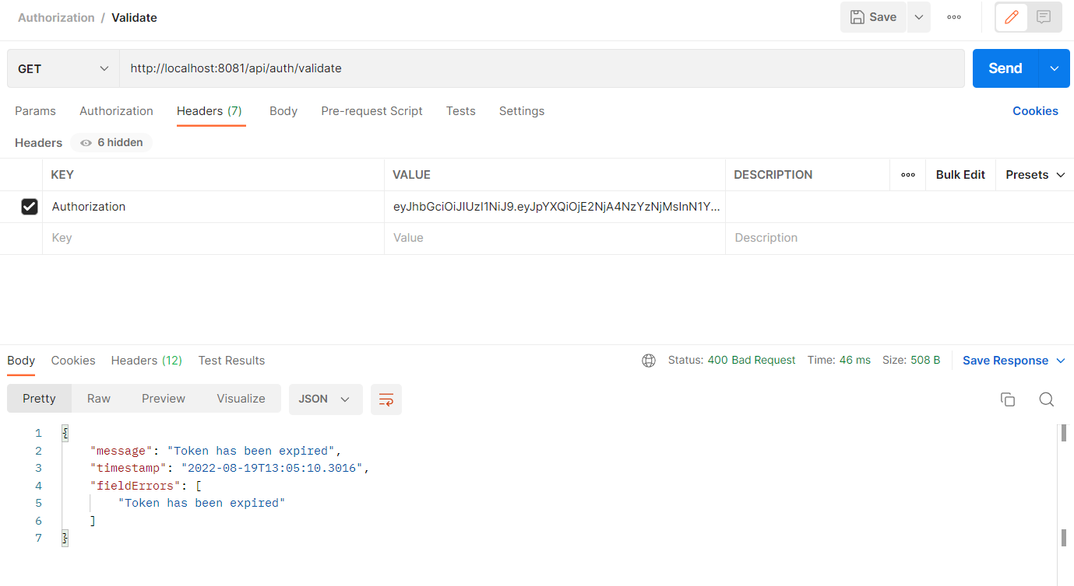
Authorization Microservice- Expired token

Slide 12
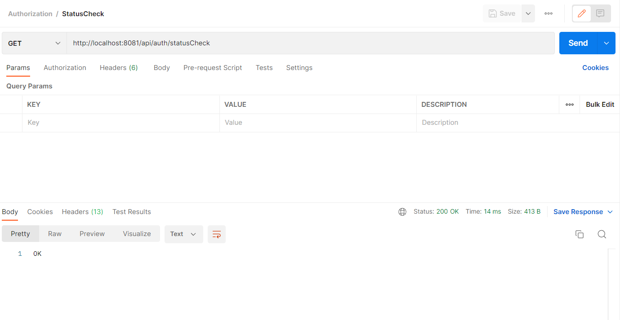
Authorization Microservice- Status Check

Slide 13

Authorization Microservice- Valid User - AWS

Slide 14
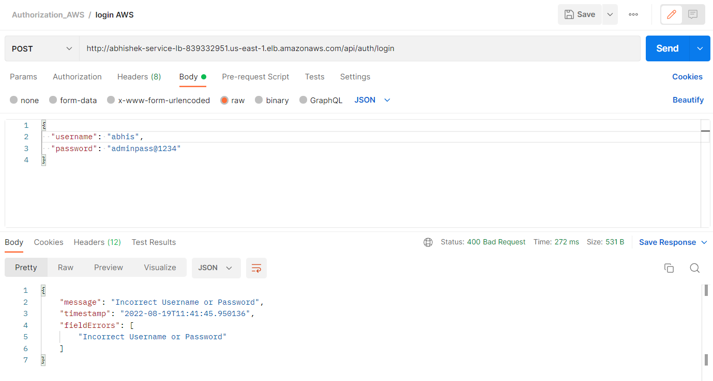
Authorization Microservice- Invalid User - AWS

Slide 15
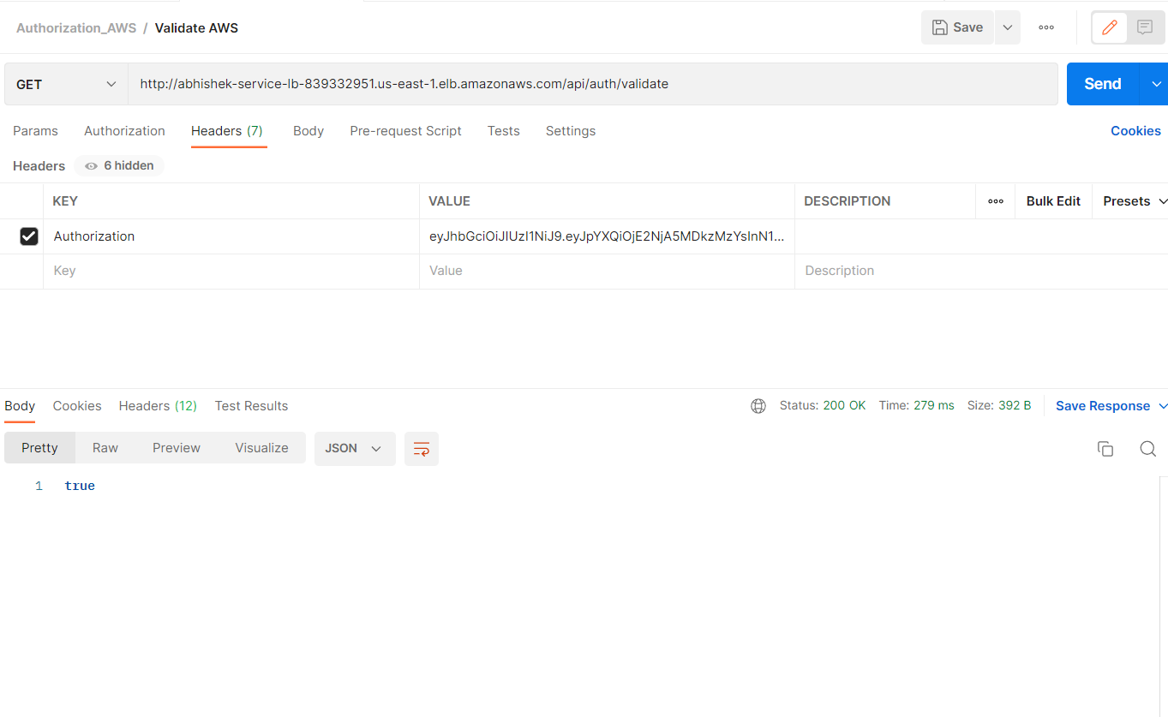
Authorization Microservice- Valid token - AWS

Slide 16
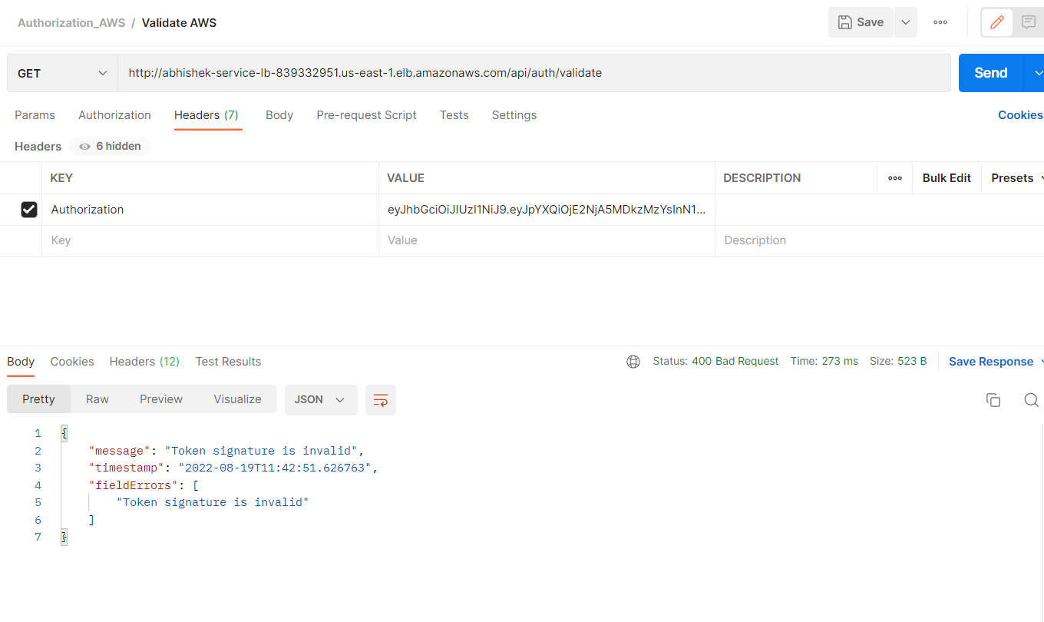
Authorization Microservice- Invalid token - AWS

Slide 17
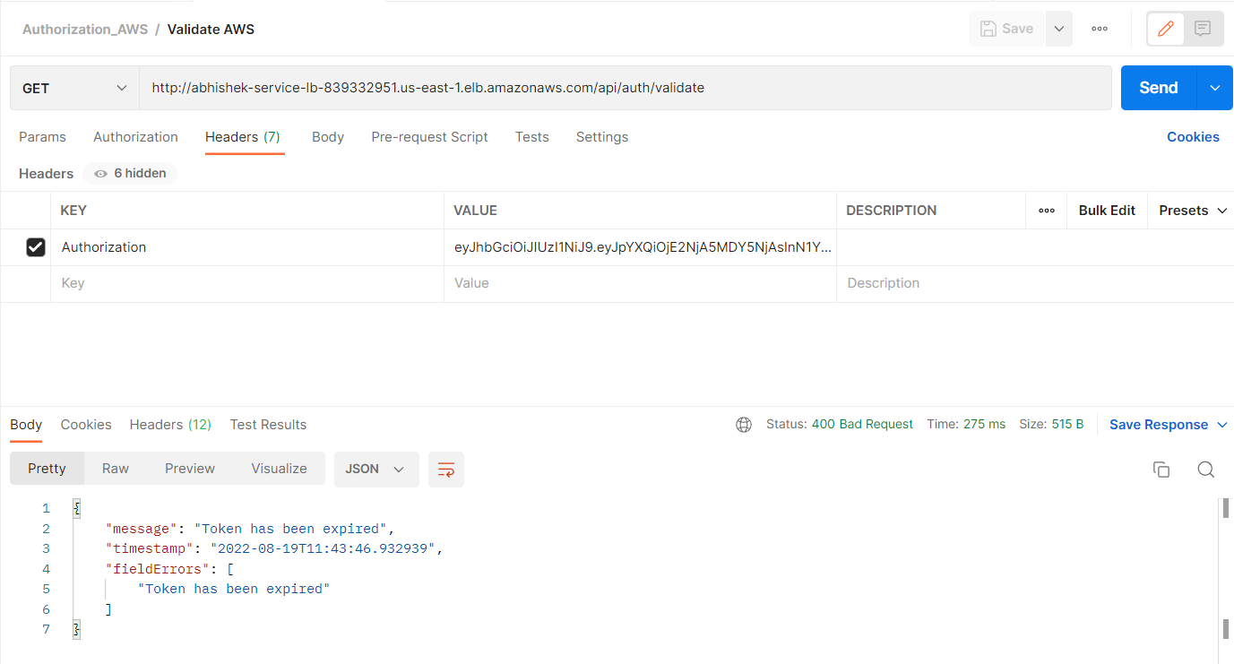
Authorization Microservice- Expired token - AWS

Slide 18
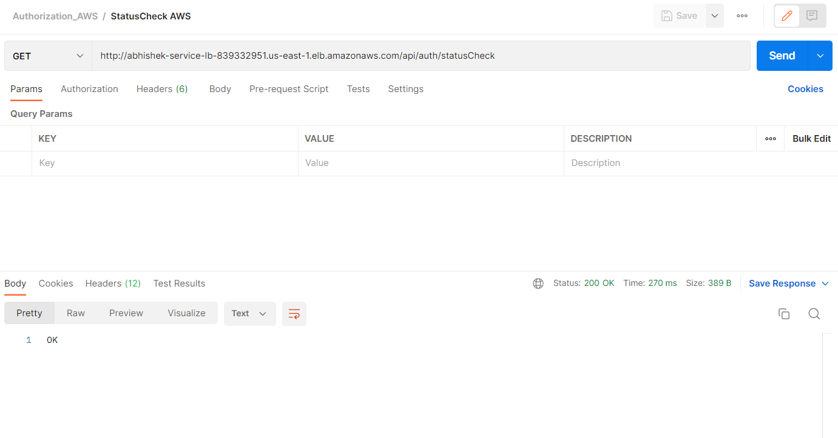
Authorization Microservice- Status Check - AWS

Slide 19
Pensioner detail Microservice:-
This microservice is consumed by Process Pension Microservice.
This microservice provides the Pensioner detail based on Aadhaar number. After Authorization using JWT, it will return pensioner detail like the name, date of birth, PAN, salary, allowance, pension type, bank name, bank account number and bank type.
This microservice has a CSV file with pre-defined 20 pensioners’ data. From the CSV file, the pensioner details based on Aadhaar number are fetched.

Slide 20
Pensioner detail Microservice:-
Localhost screenshots are from slide 21 till 24.
AWS (Cloud) screenshots are from slide 25 till 28.

Slide 21
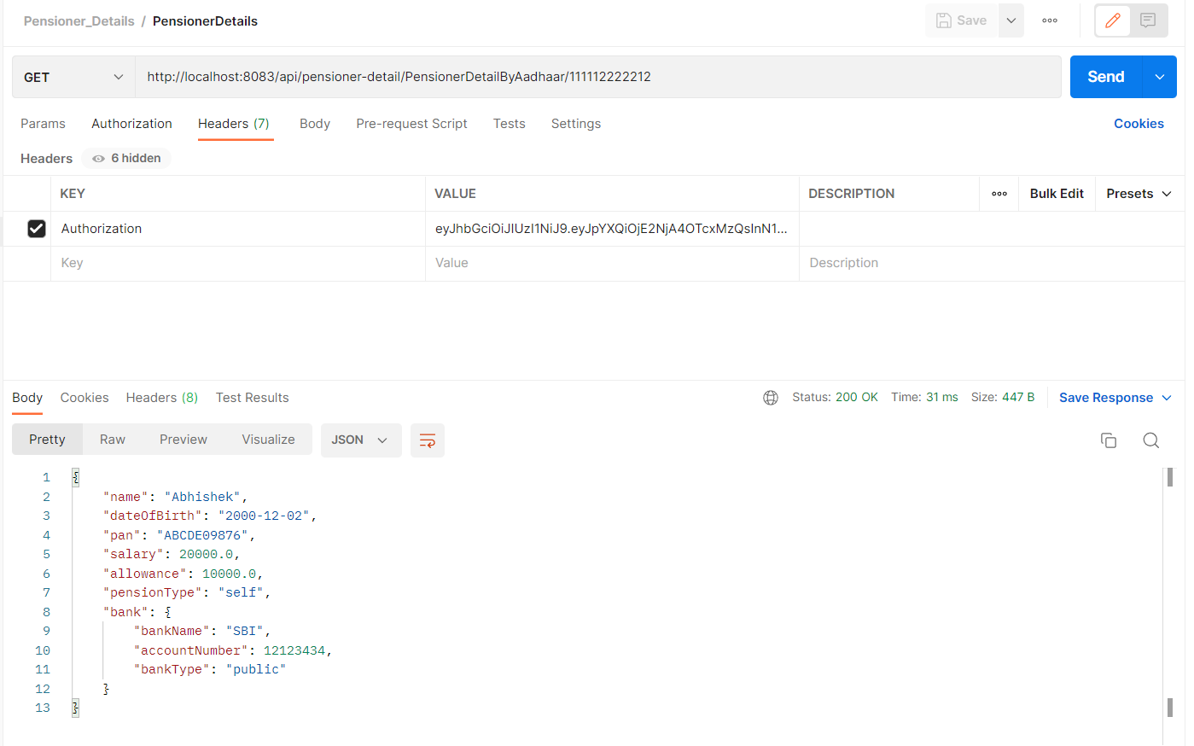
Pensioner Detail Microservice- Valid Aadhaar number

Slide 22

Pensioner Detail Microservice- Invalid Aadhaar number

Slide 23

Pensioner Detail Microservice- Expired token

Slide 24
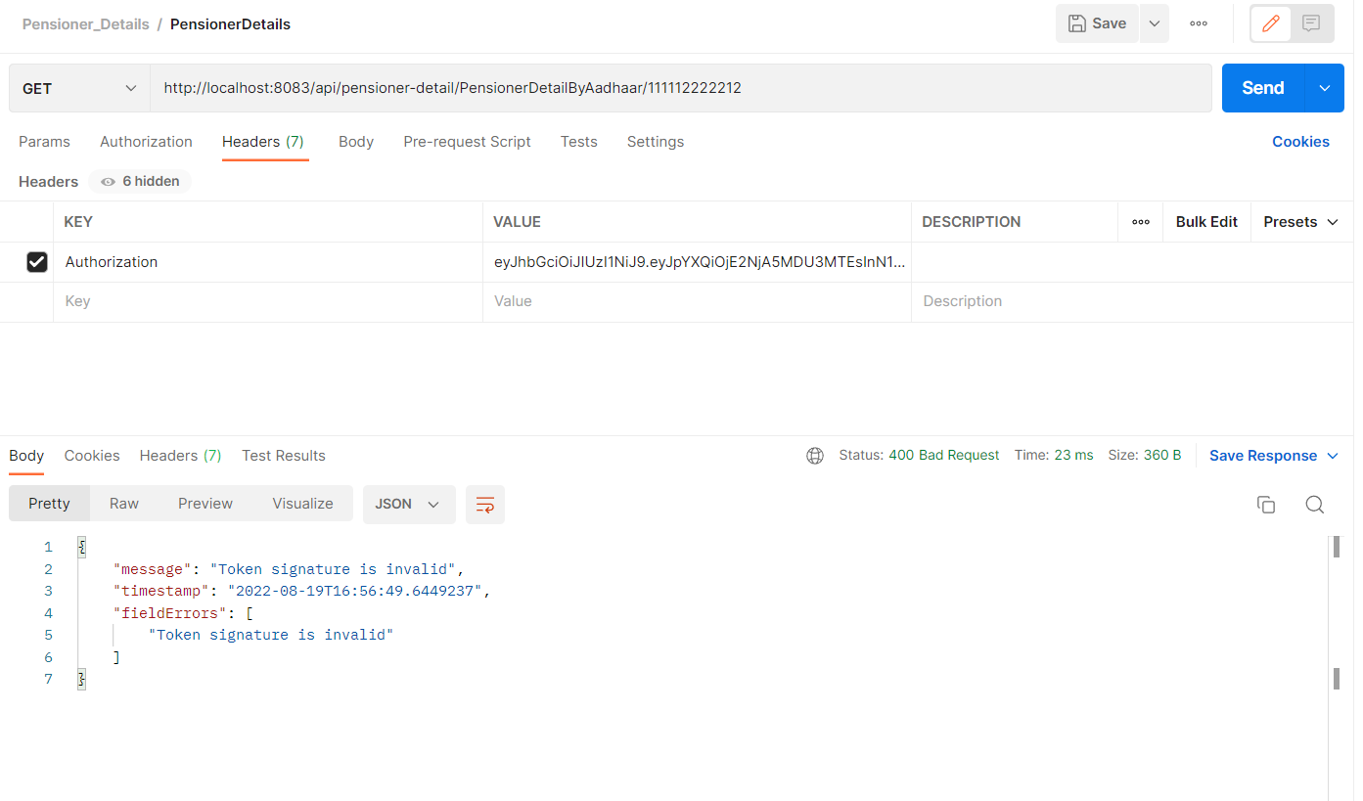
Pensioner Detail Microservice- Invalid token

Slide 25
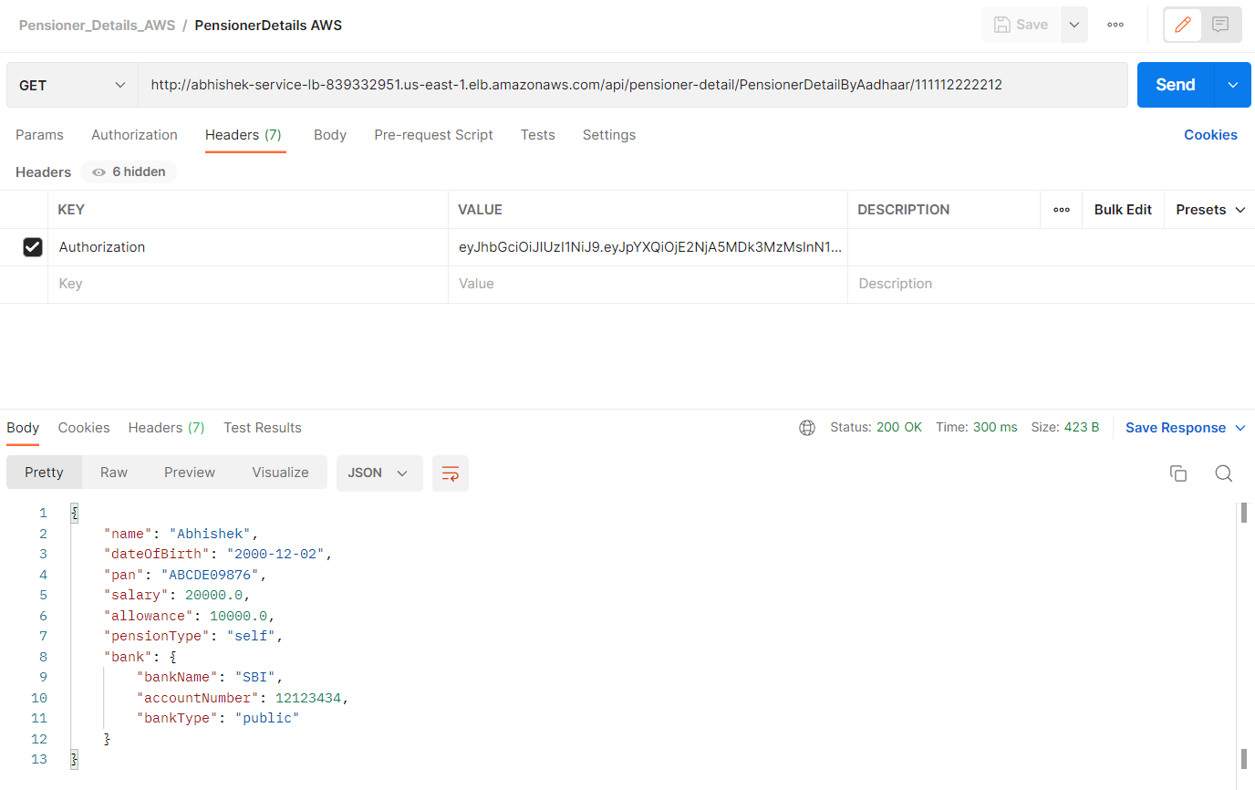
Pensioner Detail Microservice- Valid Aadhaar number - AWS

Slide 26
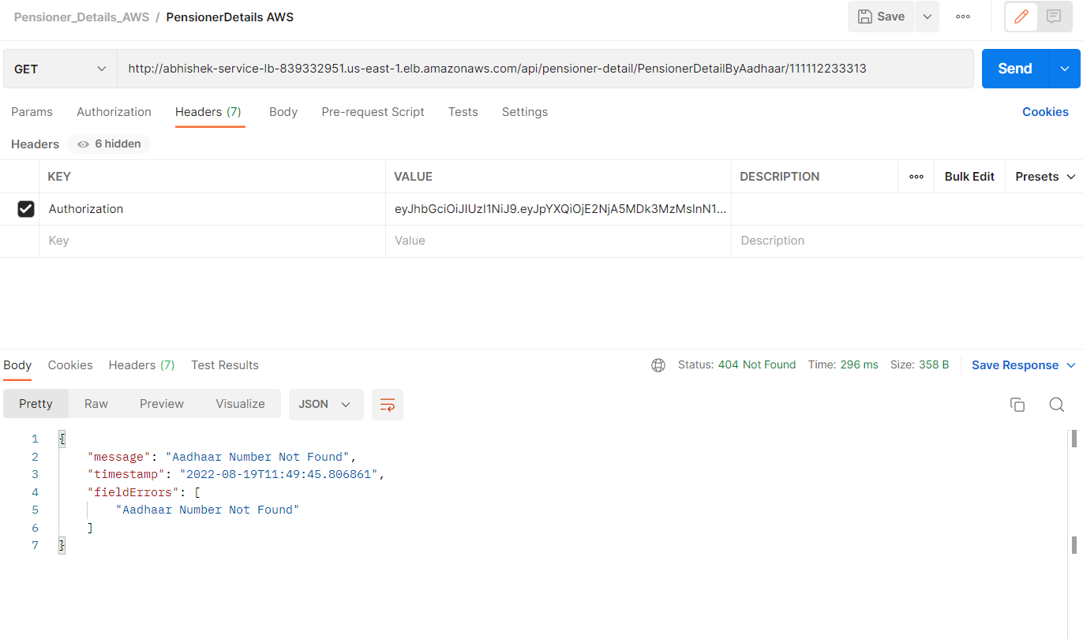
Pensioner Detail Microservice- Invalid Aadhaar number - AWS

Slide 27
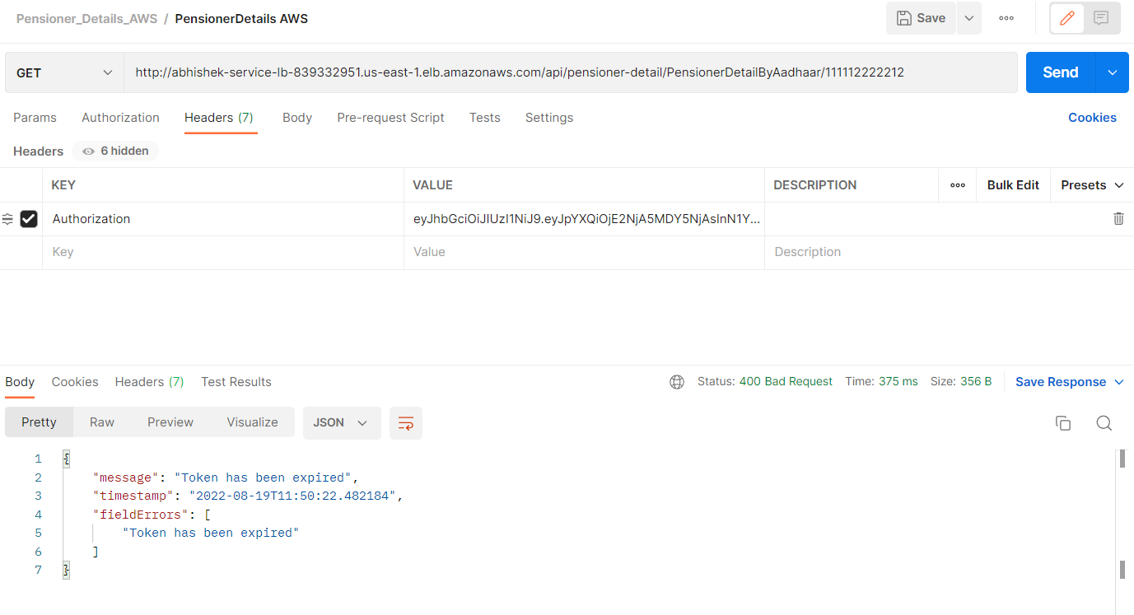
Pensioner Detail Microservice- Expired token - AWS

Slide 28
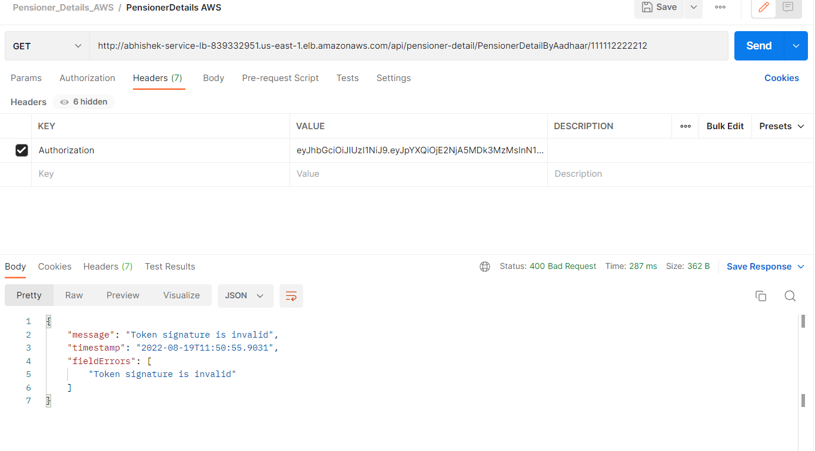
Pensioner Detail Microservice- Invalid token - AWS

Slide 29
Process Pension Microservice:-
Process Pension microservice is invoked from the angular front-end application.
This microservice has one endpoint.
It takes in the pensioner detail like the Aadhaar number, name, date of birth and pan (calling this as pensioner input hereonwards).
Verifies if the input provided is correct by contacting Pensioner Detail microservice .
If not, error message is displayed.
If valid, then pension calculation is done and the pension detail (pension amount and bank service charge) is returned to the Web application to be displayed on the UI.
Saves the input (pensioner input), output (pension detail) and the corresponding pensioner details (from Pensioner Detail microservice) in the database.

Slide 30
Process Pension Microservice:-
Localhost screenshots are from slide 31 till 35.
AWS (Cloud) screenshots are from slide 36 till 40.

Slide 31
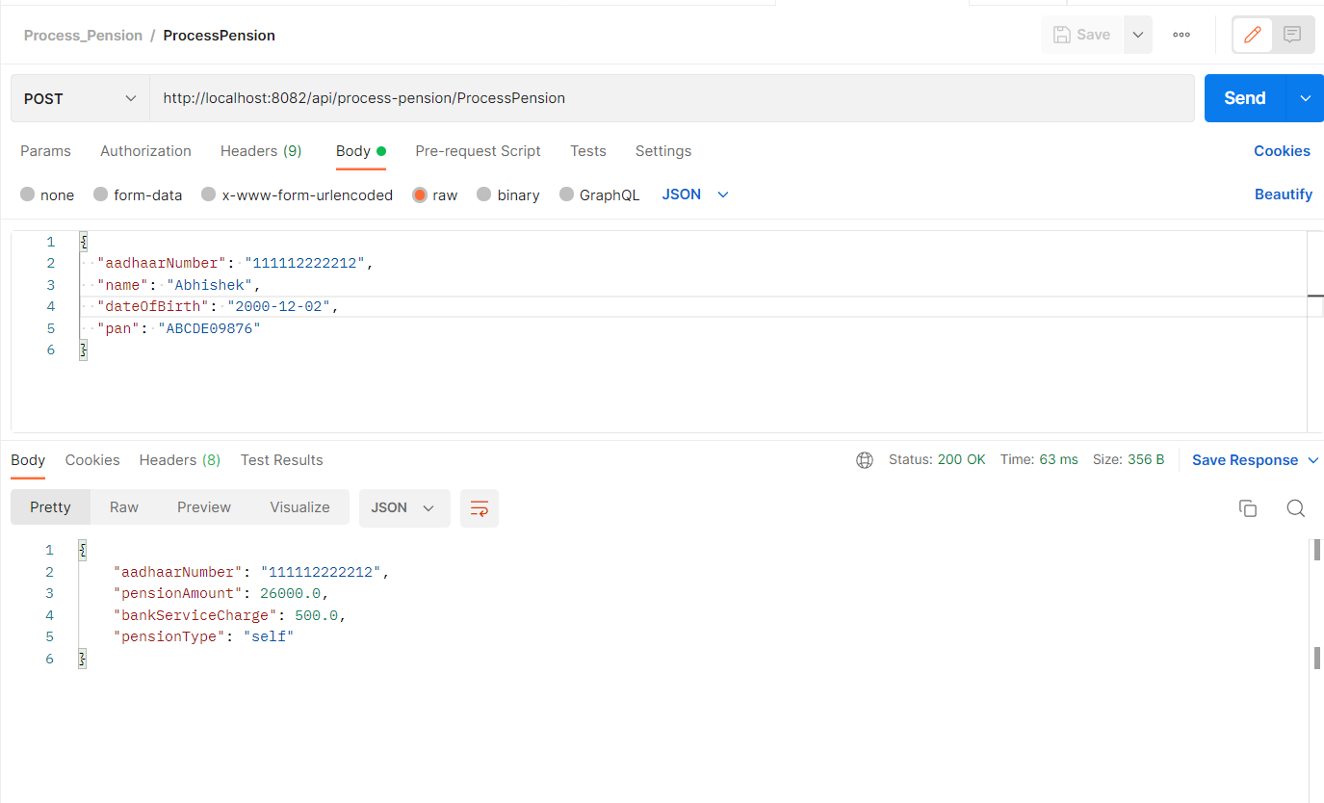
Process Pension Microservice - Valid Pensioner Input

Slide 32
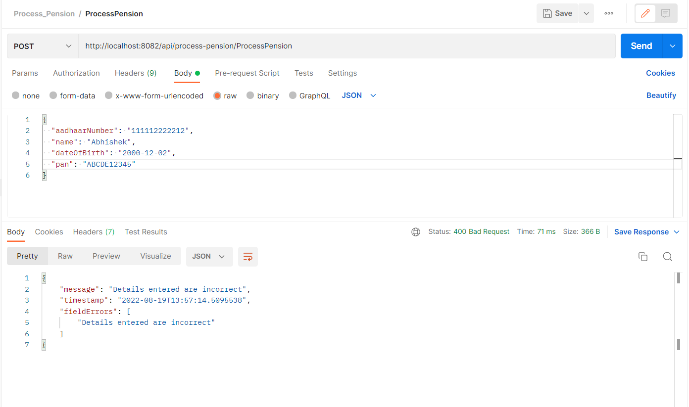
Process Pension Microservice - Invalid Pensioner Input

Slide 33
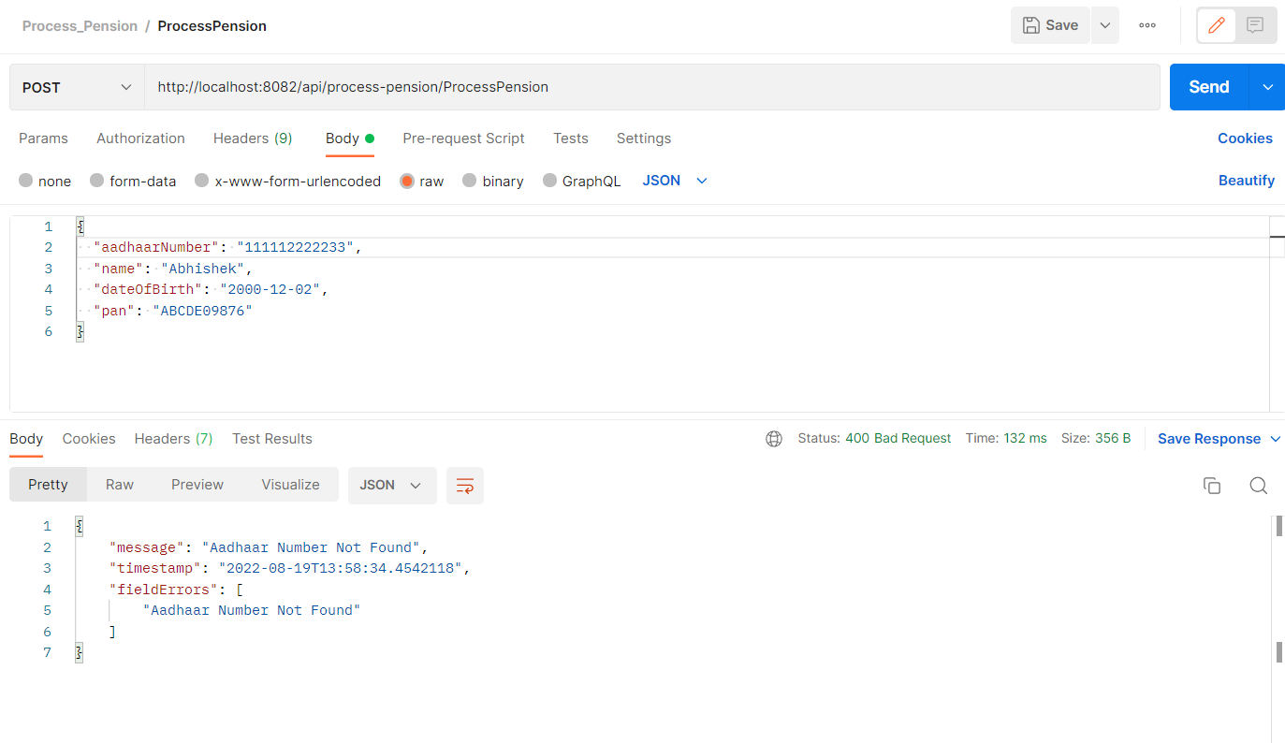
Process Pension Microservice - Invalid Aadhaar number

Slide 34

Process Pension Microservice - Expired token

Slide 35
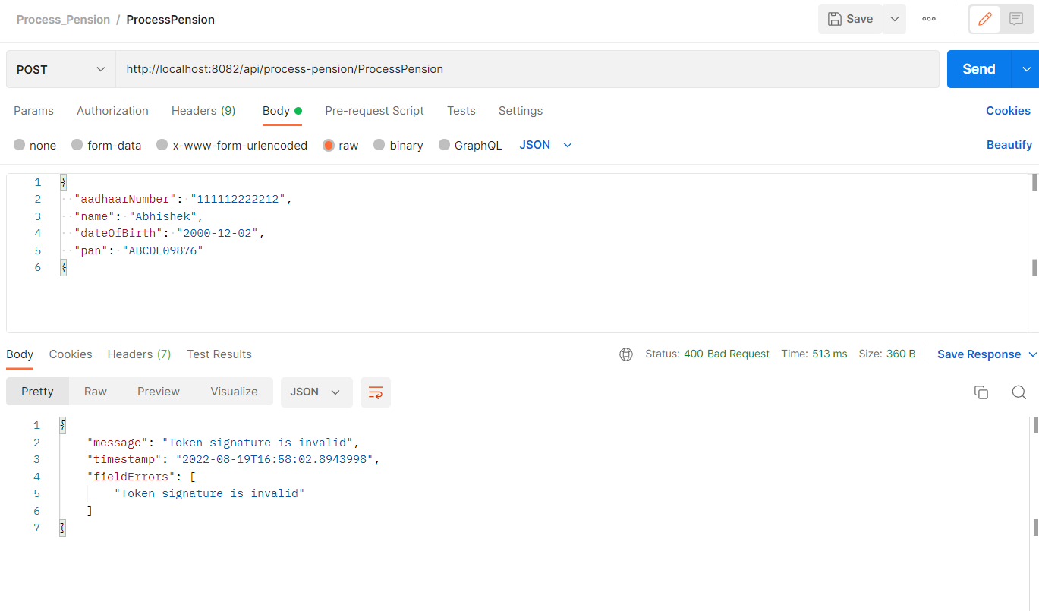
Process Pension Microservice - Invalid token

Slide 36
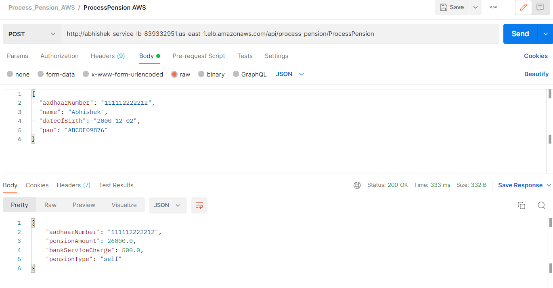
Process Pension Microservice - Valid Pensioner Input - AWS

Slide 37
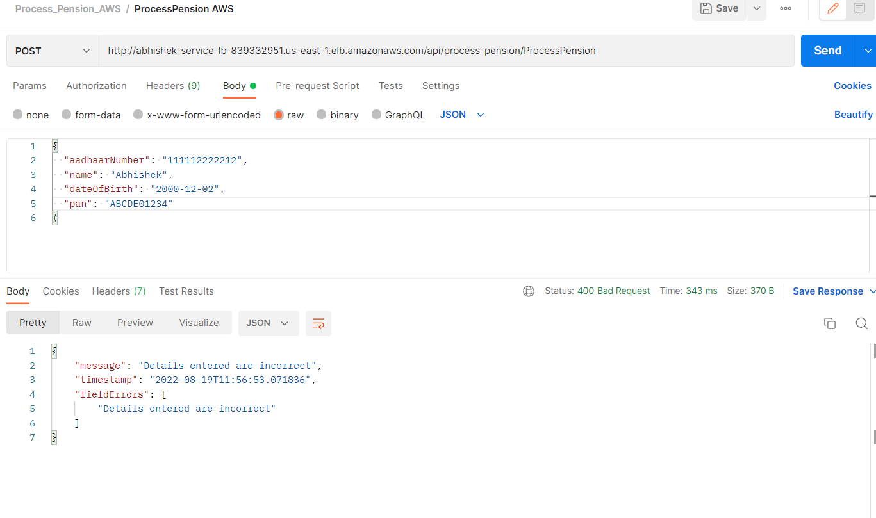
Process Pension Microservice - Invalid Pensioner Input - AWS

Slide 38

Process Pension Microservice - Invalid Aadhaar number - AWS

Slide 39
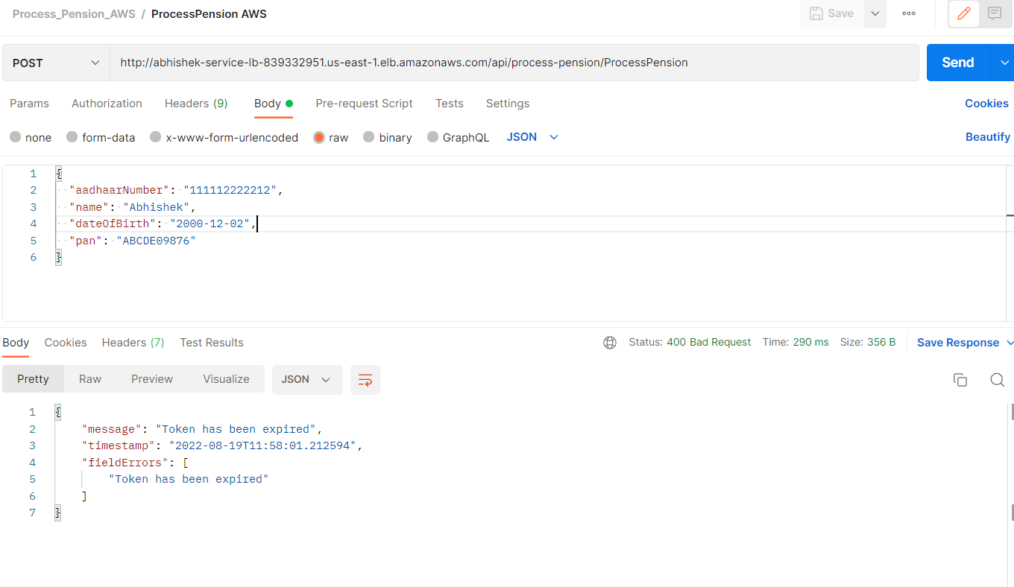
Process Pension Microservice - Expired token - AWS

Slide 40
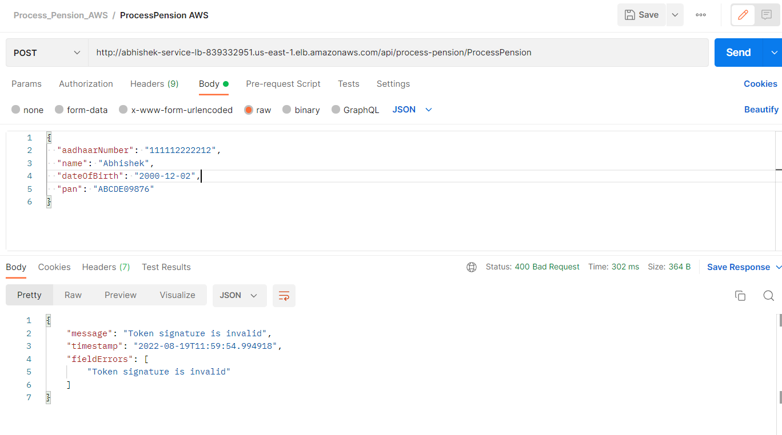
Process Pension Microservice - Invalid token - AWS

Slide 41
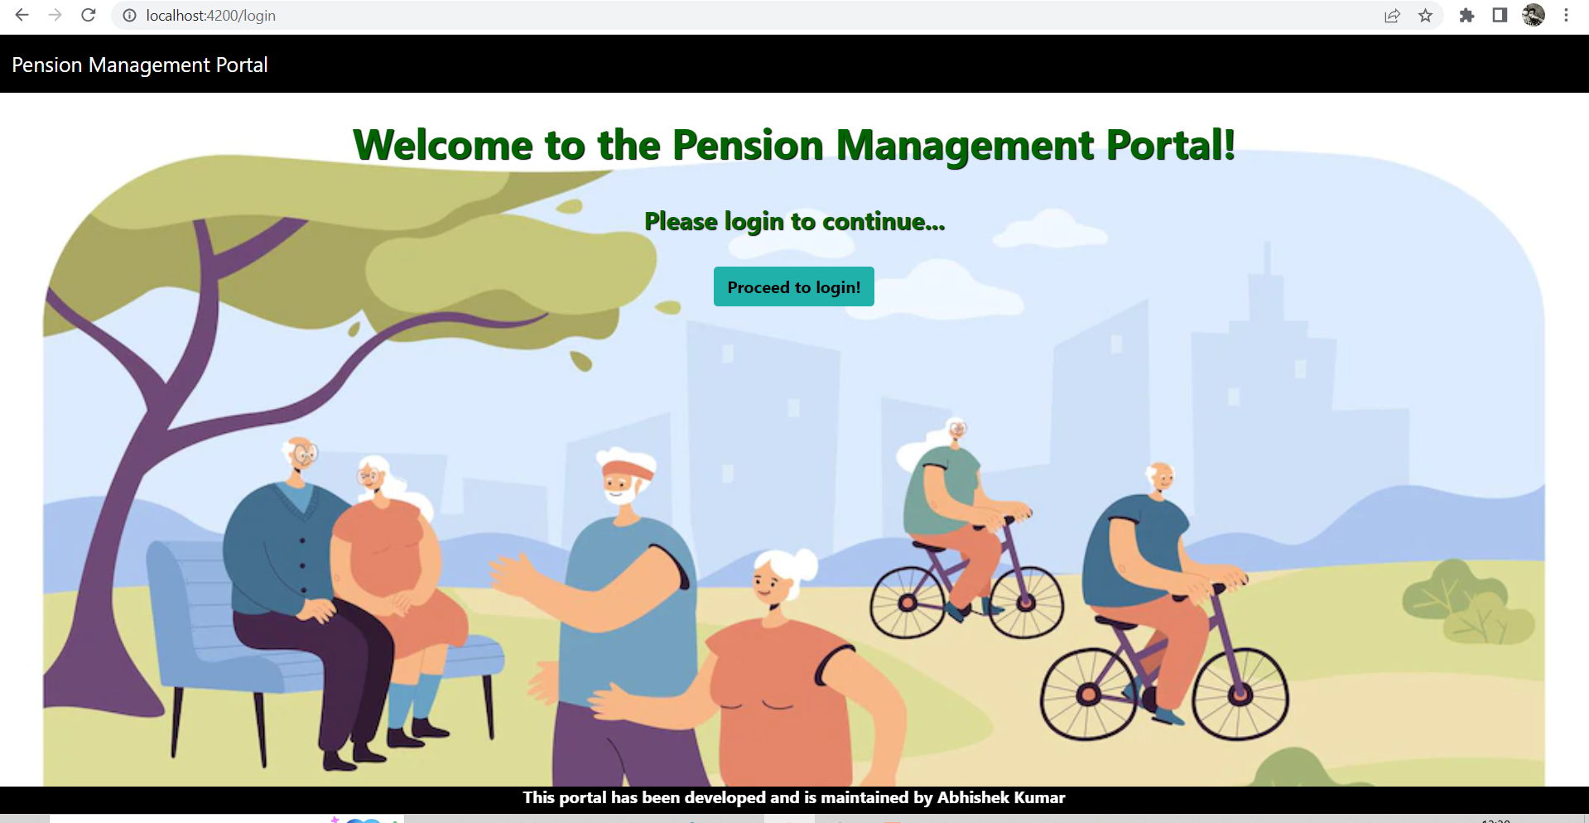
Front-end Login Screenshot1

Slide 42
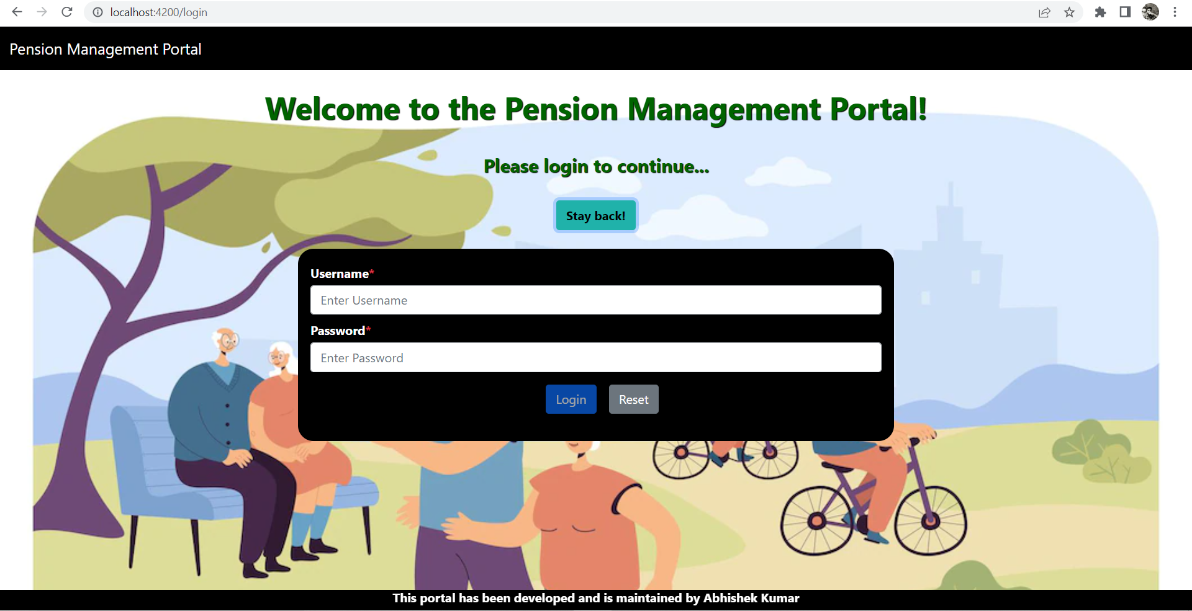
Front-end Login Screenshot2

Slide 43
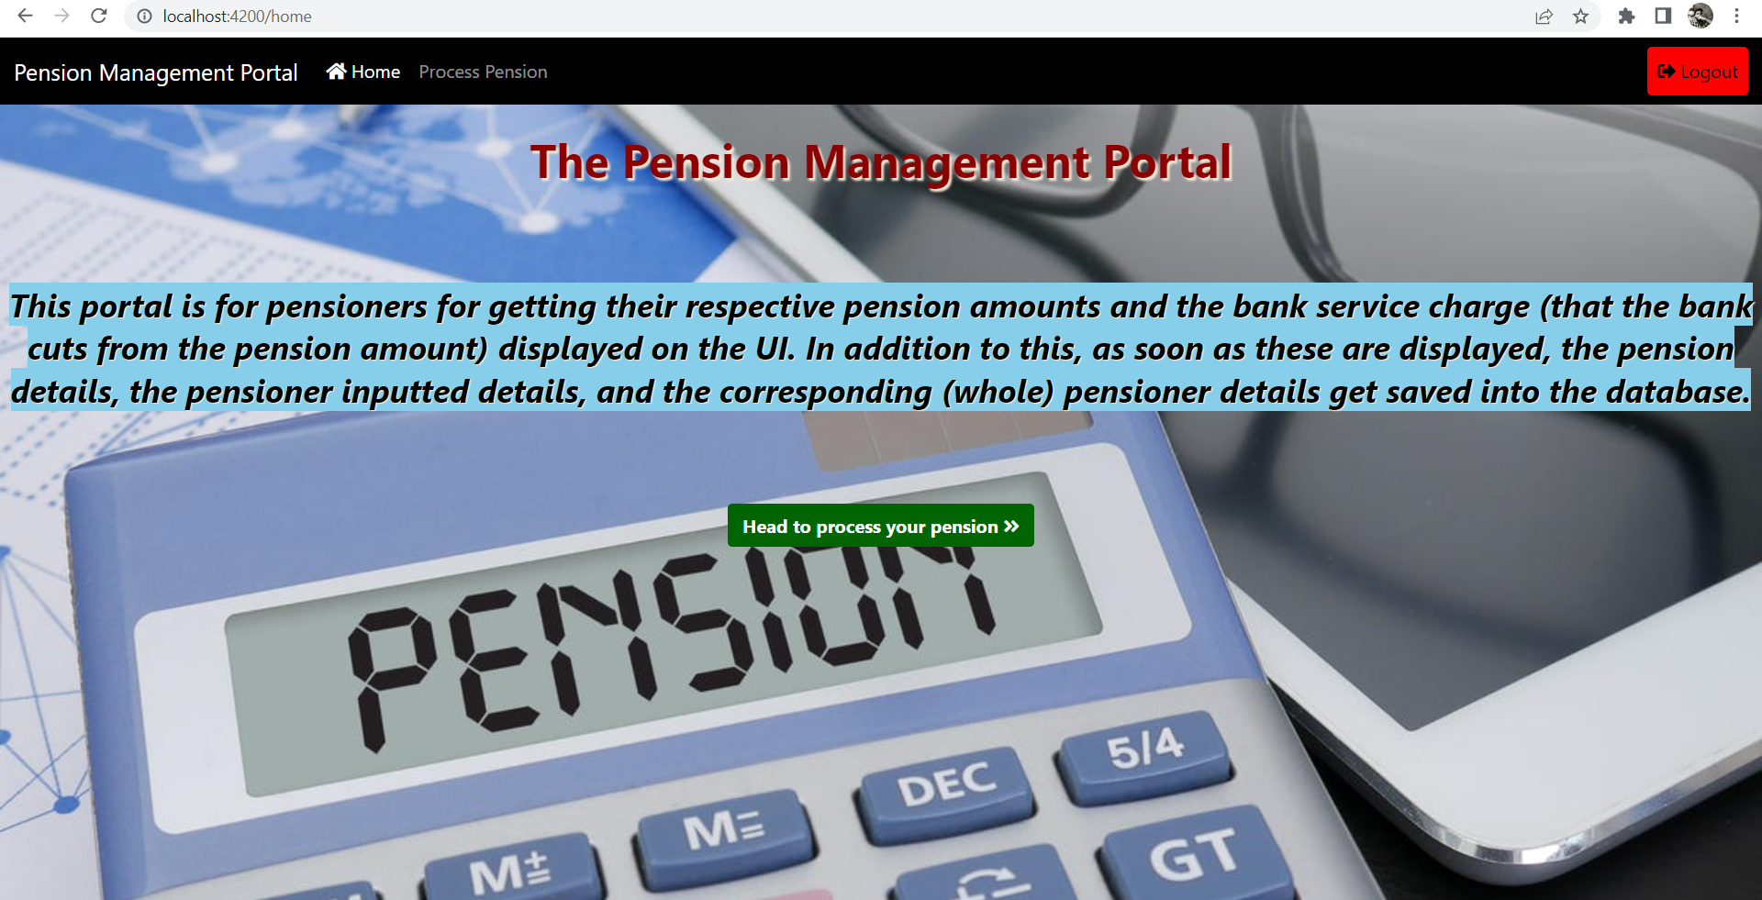
Front-end Home Screenshot

Slide 44
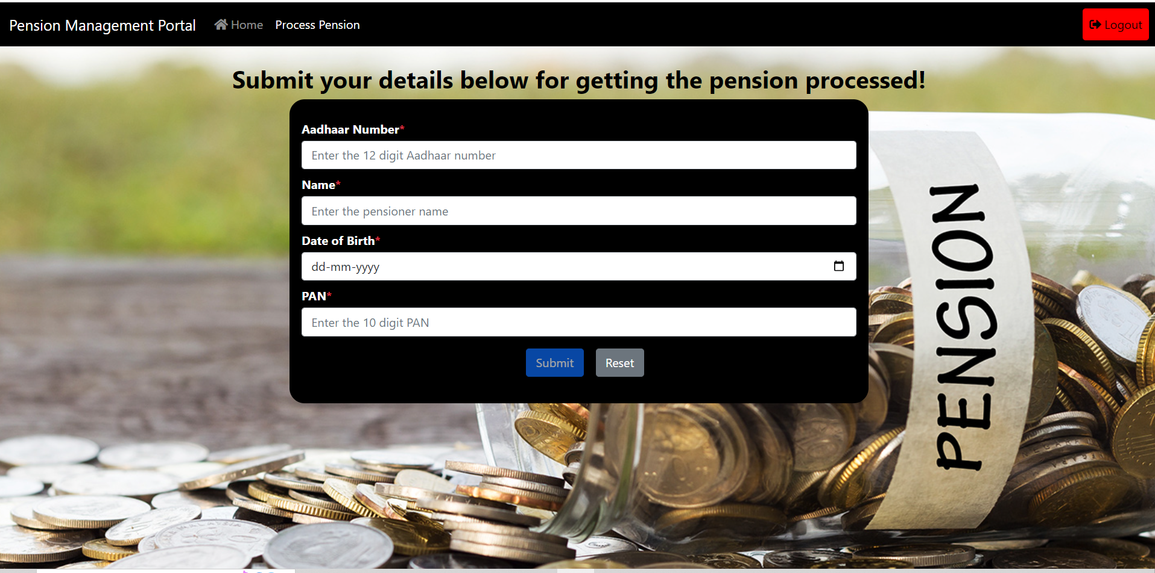
Front-end Pension Detail Screenshot1

Slide 45
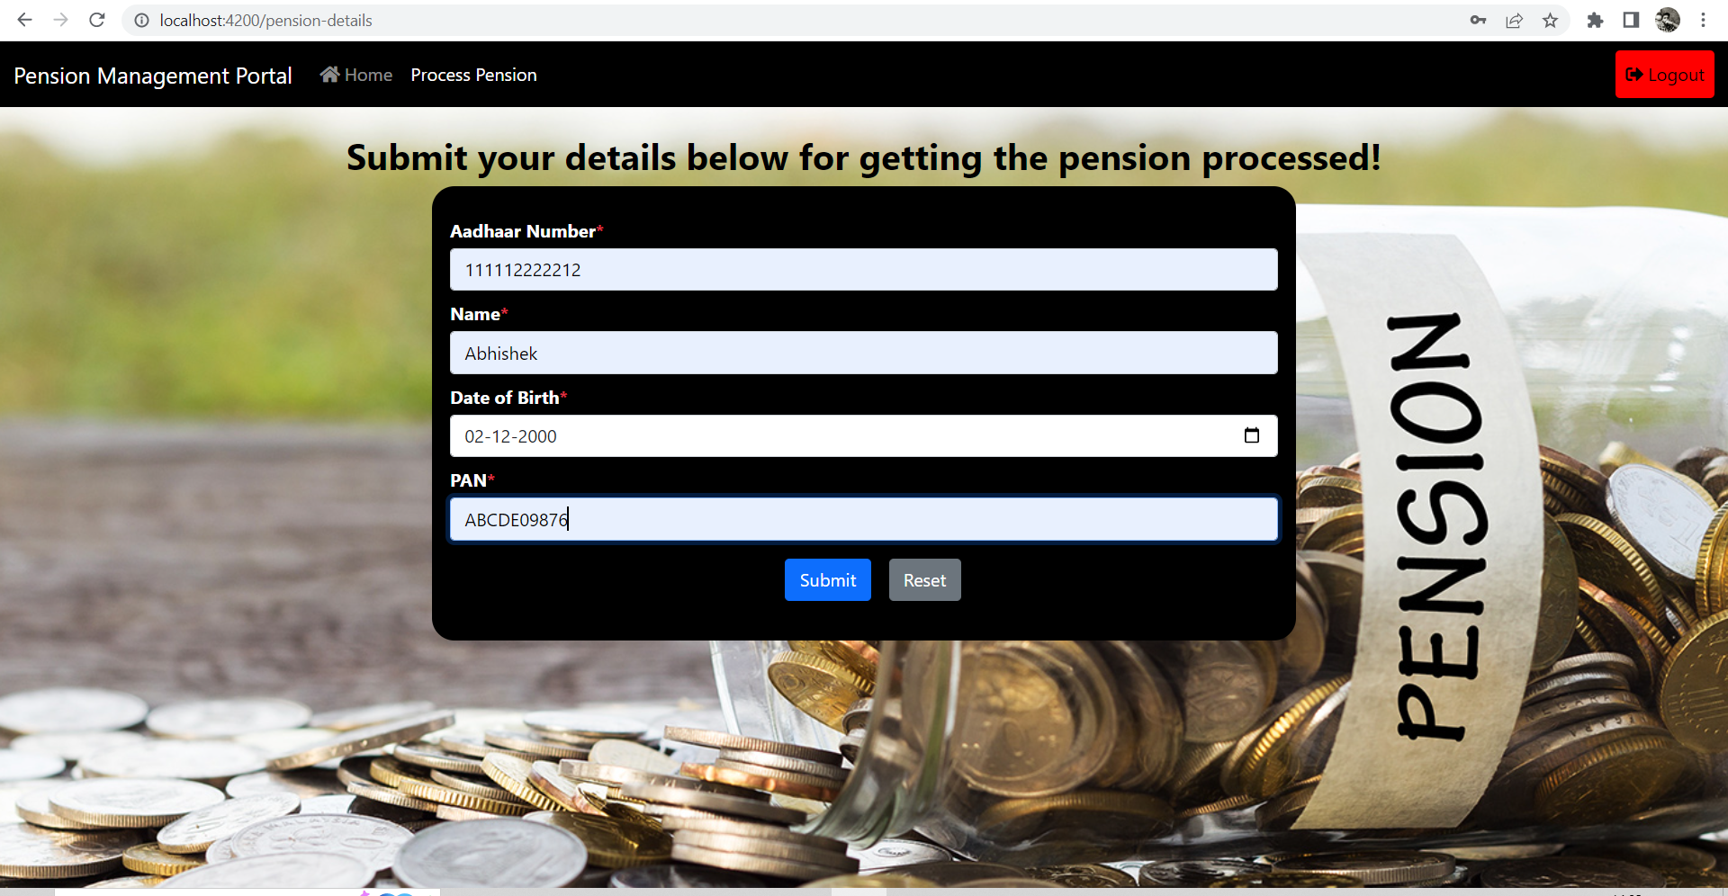
Front-end Pension Detail Screenshot2

Slide 46
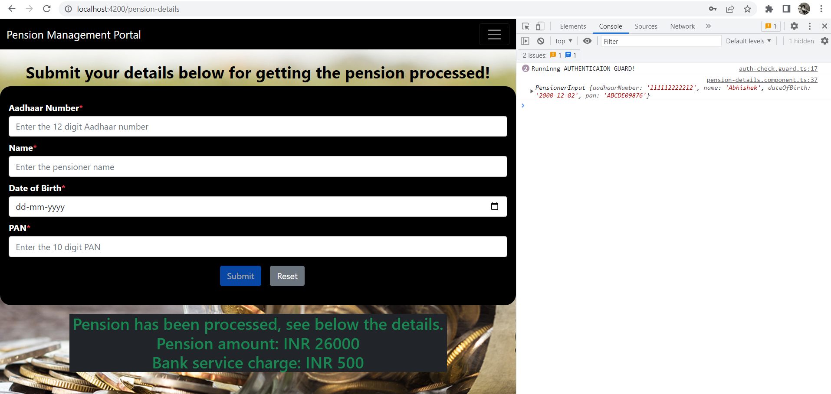
Front-end Pension Detail Screenshot3

Slide 47
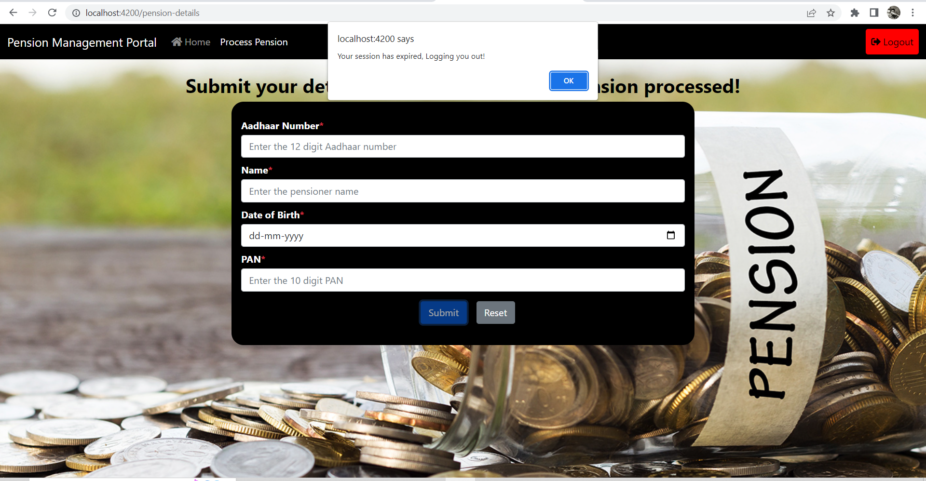
Front-end Session Expired Screenshot

Slide 48
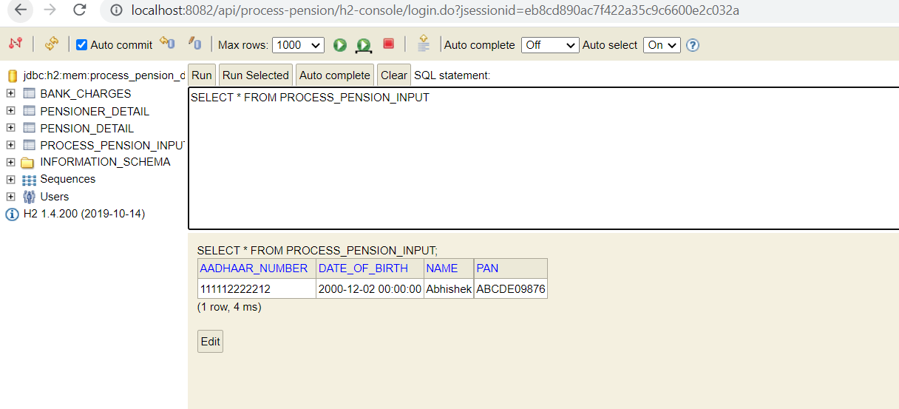
Database Screenshot1

Slide 49
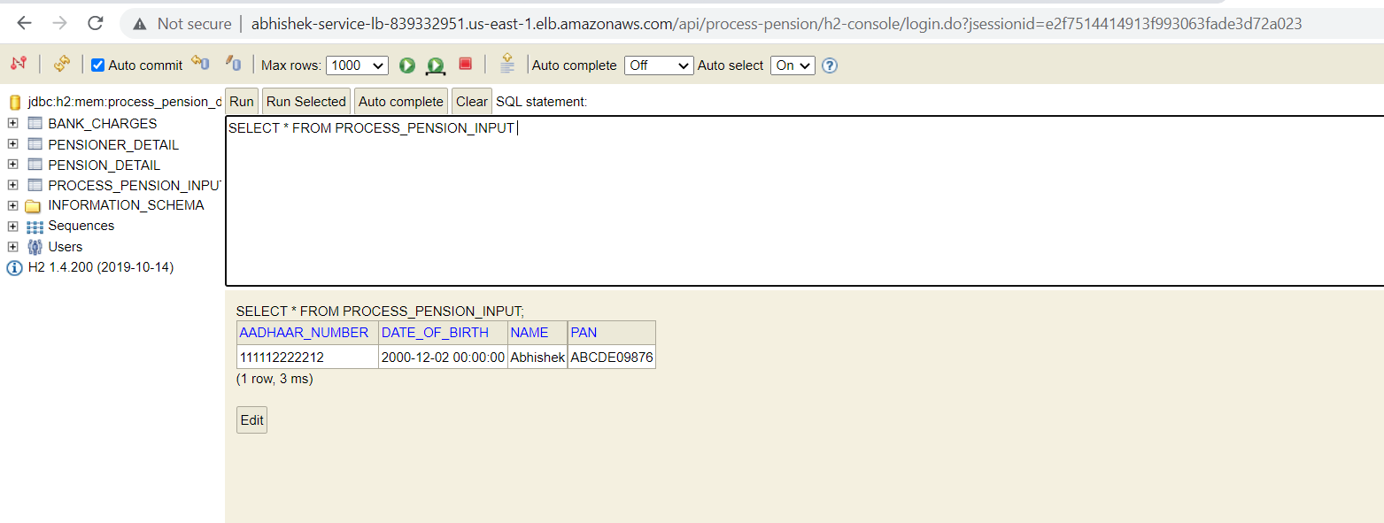
Database Screenshot1 - AWS

Slide 50
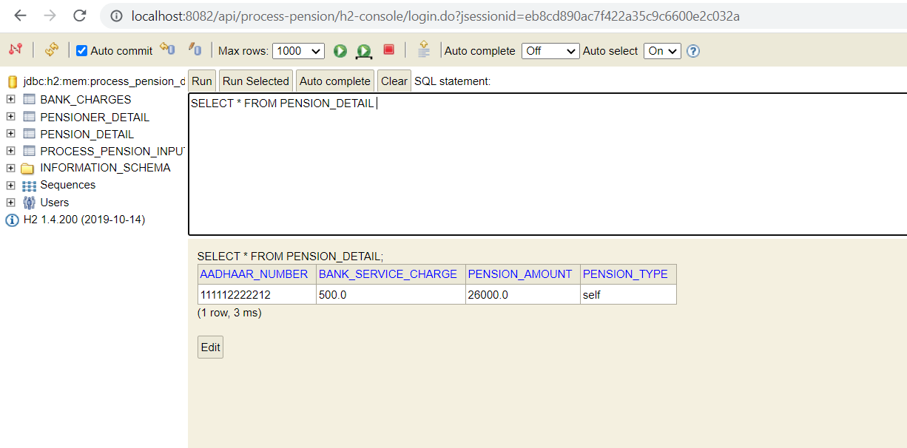
Database Screenshot2

Slide 51
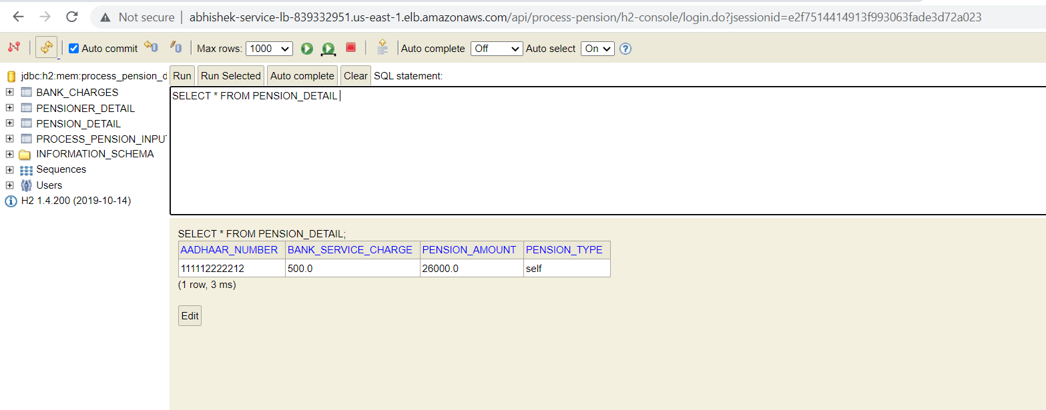
Database Screenshot2 - AWS

Slide 52
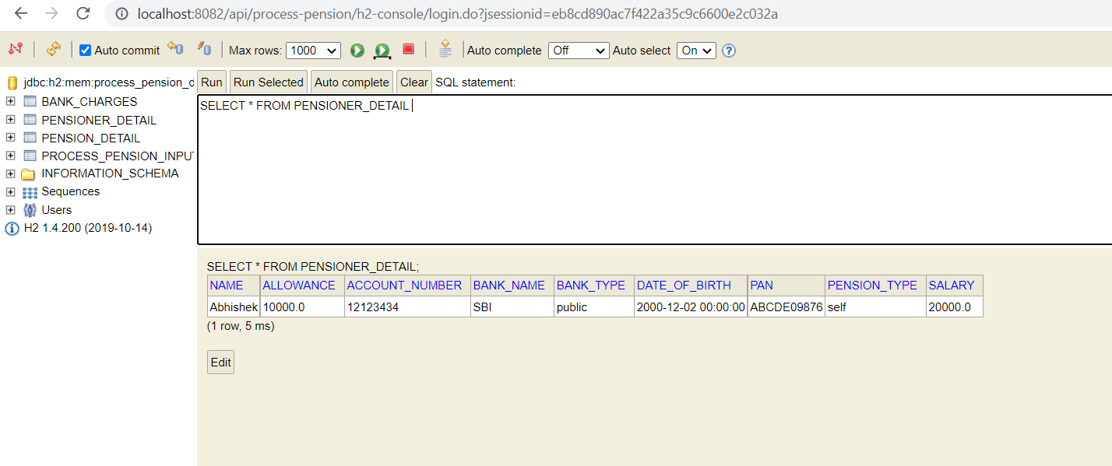
Database Screenshot3

Slide 53
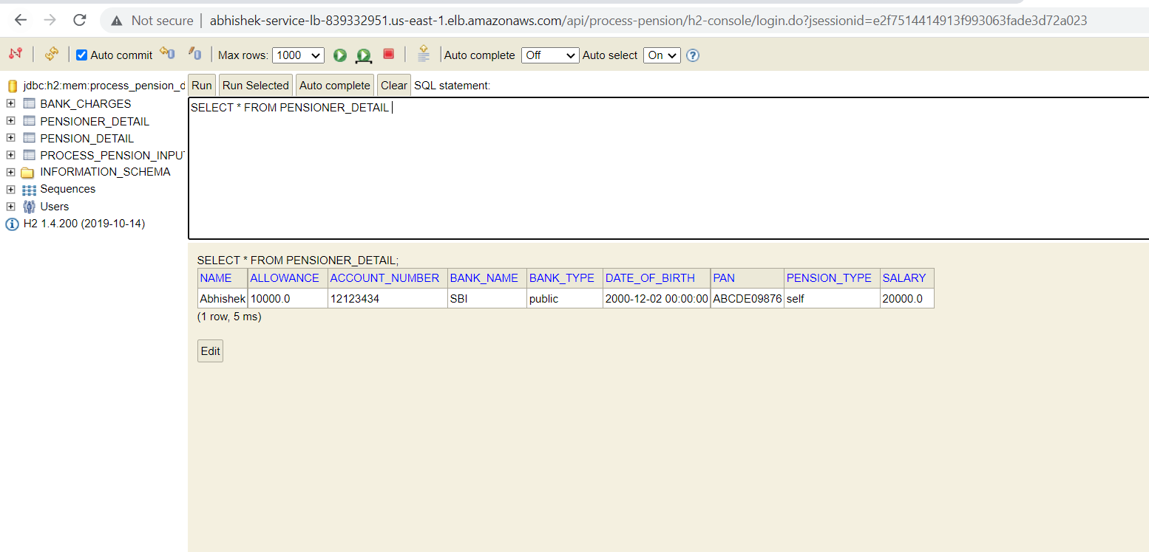
Database Screenshot3 - AWS

Slide 54
THANK YOU!

